Slide 1

Stock Market Data And Analysis In Python
Guide – Dr. Venkat Prasad Padhy

Slide 2
TEAM MEMBERS
SREEPRADA CHINTAGINJALA (20MIP10049)
TELUGUNTI AKHIL (20MIP10045)
JAHNAVI GADIPUDI (20MIP10040)
MANOJ SEN (20MIP10022)
VIVEK KUMAR SAHU (20MIP10042)

Slide 3
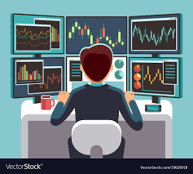
INTRODUCTION
The stock price of the company reflects the net evaluation of the company and also gives a little insight into its performance. These stocks are traded on exchanges and their prices are constantly changing due to their demand and supply in the market.
If a stock is in high demand and low in supply i.e. more people want to buy it and fewer people are willing to sell it then the price for the stock will go up and similarly if the stock is in low demand and high on supply which means more people are ready to sell it but fewer people are willing to buy it then its prices go down.
These stock prices going up and down is an iterative process and repeated. This volatility of stock makes investors nervous while investing in a company. So to understand the risk associated with it there must be a proper analysis of stock before buying it.
So we will give you a proper stock market analysis using python which will lower your risk by more than 20%. As 20% is a big number when it comes to share market
"Returns matter a lot. It's our capital."
— Abigail Johnson

Slide 4
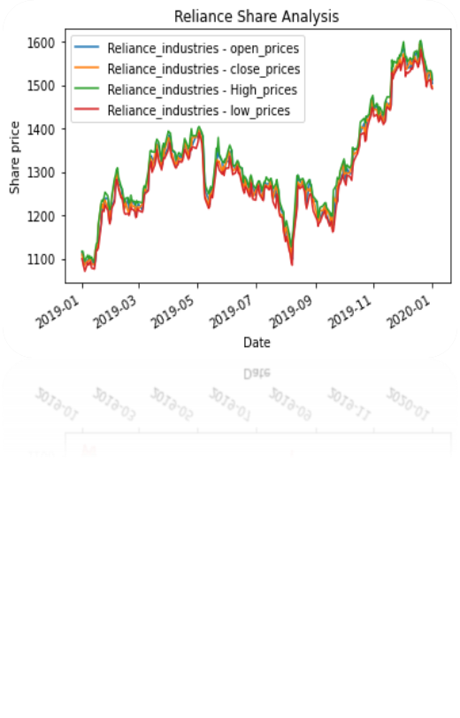
PRE-EXISTING WORK
We have shown you how data analysis can be done after seeing the data numbers.
We have imported all the data of the stock by YAHOO FINANCE website using pandas data reader in which we have shown the Opening price, Closing price, High prices and Low prices of the stock in a specific time and date by just typing the Symbol of the stock.
We have also plotted the graphs of the individual stock in all the aspects for getting better understanding and analysis of the stock because when we see the graphical representation we get the better analysis of numbers and numerical data.
As you can see in the right side we have given one example of the graph that we have plotted last time and we have also shown the comparison of all the stocks in various graphs format like Histogram, Line graph, Scatter charts etc.

Slide 5
Proposed work
FINDING AND ANYLYZING THE STOCKS DATA WITH GRAPHS, ESTIMATION PRICE, PREVIOUS TRADES AMOUNT AND THEIR FUNDAMENTALS SO THAT INVESTORS CAN GET A MINIMUM LOSS AFTER INVESTING.

Slide 6
REAL TIME USES
Real-time data allows you to move with the market instead of playing catch up.
If you want to remain ahead of the curve and stay competitive in your market, you need to work with data delivered in real-time.
Volume data is counted on by technical traders. It indicates how seriously they should scrutinize a stock's price upward movement.
Market values will fluctuate on a dime. These evolving values can impact your analysis of a stock, so it's imperative that you're taking advantage of the most updated information.
Using real-time data, you can see the potential gain or loss you might incur at that moment. The profit and loss will recalibrate with each notch in a stock's price.

Slide 7

SYSTEM ARCHITECTURE DIAGRAM

Slide 8
YAHOO Finance Data
Traded quantity
Trend
Continuous UP/DOWN
Volume Variation
PREDICTION
MODEL
TRUE
Trend > threshold
FALSE
UP
DOWN

Slide 9

LITERATURE REVIEW
• How to analyse stock data with Python - Satoshi goto
• Stock Technical analysis with Python-Created by diego Fernandez
• How to implement Financial Trading Strategies- Bob Mather
• Trading evolved(Anyone can build killer Trading Strategies in Python)-Andreas F. Clenow
• Stock Market Analysis in Python- Faizan Ahmed
• Stock Prediction in Python- Will Koehrsen

Slide 10
MODULE
DATA COLLECTION.
PRE-PROCESSING OF DATA.
IDENTIFYING TRENDS.
MAKING PREDICTION.

Slide 11
MODULE WORK FLOW

Slide 12
IMPLEMENTATION AND CODING
WE HAVE IMPORTED STOCK MARKET DATA USING YAHOO FINANCE WEBSITE THROUGH PANDAS DATA READER.
WE HAVE IMPORTED SPECIFIC DATA FROM STARTING DATE TO ENDING DATE USING DATE TIME MODULE.
WE HAVE USED MATPLOTLIB FOR PLOTTING THE GRAPHS AND PANDAS PLOTTER LIKE SCATTER MATRIX IS ALSO HAVE BEEN USED FOR GETTING THE BETTER UNDERSTANDING OF THE NUMERIC DATA.
SPEICFIC STOCK DATA ANALYSIS IS ALSO HAS BEEN DONE THROUGH GRAPHS BUT FOR MORE SPECIFIC DATA COMPARISON BETWEEN 2 AND 3 STOCKS ALSO HAVE BEEN DONE SO THAT MIDCAP COMPANIES, LARGECAP COMPANIES AND SMALLCAP COMPANIES DATA CAN ALSO BE COMPARED AND GIVE BETTER UNDERSTANDING BETWEEN THE STOCKS TO INVEST IN.
FOREIGN COMPANIES STOCKS LIKE GOOGLE, AMAZON, NETFLIX, FACEBOOK STOCKS DTA ANALYSIS HAS BEEN ALSO DONE TO CALCULATE RISK AND EXPECTED RETURNS FOR UPCOMING TIME.

Slide 13
PROJECT WORK
SNAP SHOT OF OUR PROJECT
DEMO VIDEO
TESTING

Slide 14
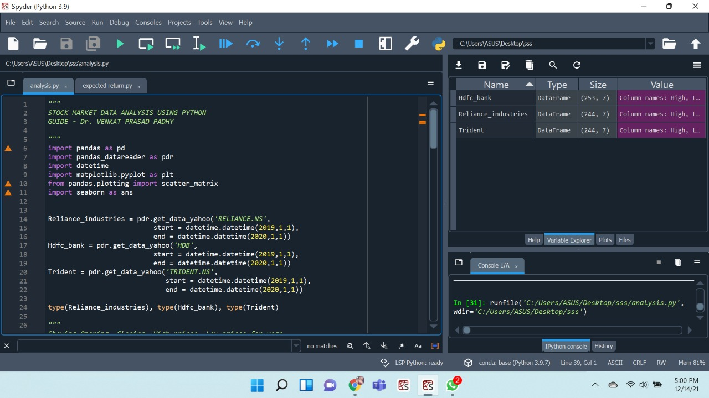
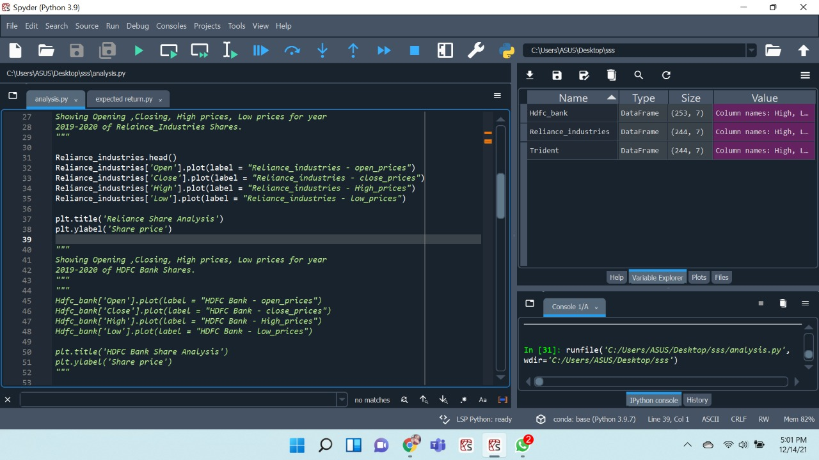

Slide 15
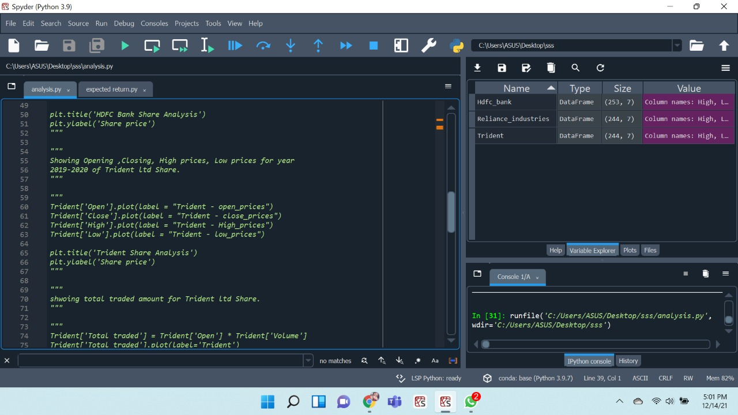
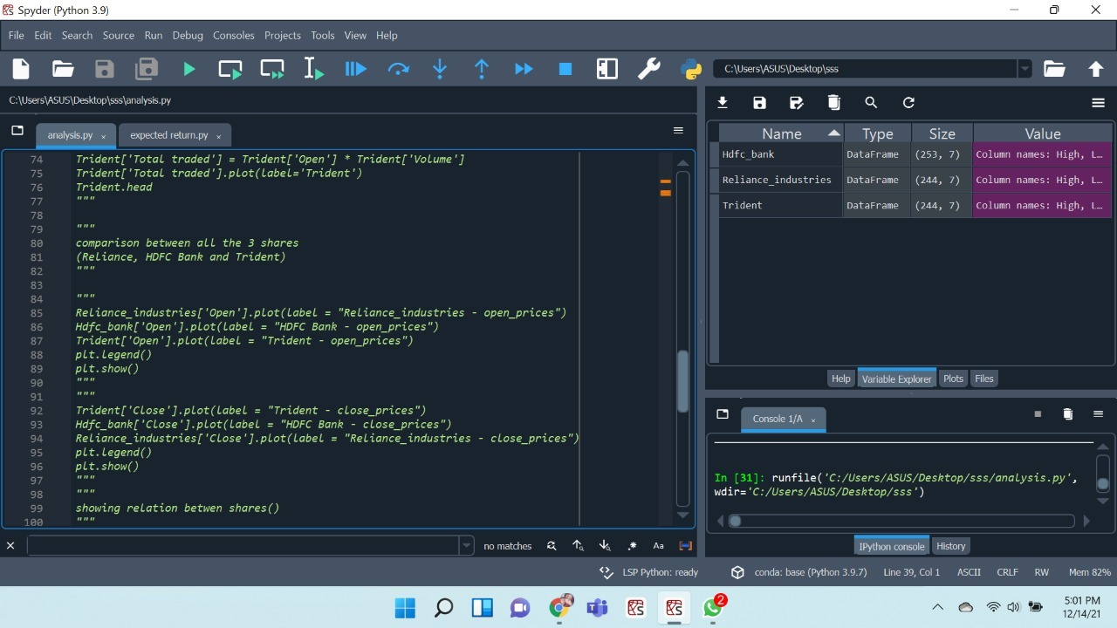

Slide 16
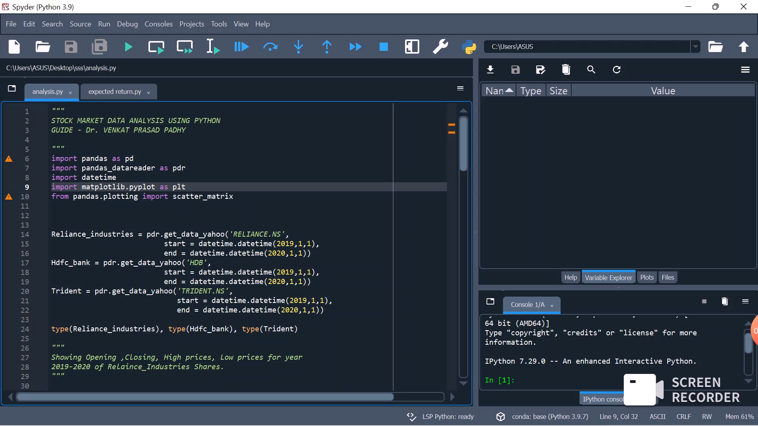
DEMO VIDEO

Slide 17

Stocks market are volatile. Prices change according to supply and demand Stock market analysis helps you to find the right stock and sectors to invest and make a lot of money. Technical analysis is more for the traders to identify potential short-term stocks and make quick money. On the other hand, fundamental analysis deals with finding the hidden gems in a sector and investing money for the long term and get money returns in multiples.
Governments of most countries invest a part of their healthcare, employment, or retirement funds into stock markets to achieve better returns for everyone. Online trading services have already revolutionized the way people buy and sell stocks. The financial markets have evolved rapidly into a strong and interconnected global market place.

Slide 18
RESULT AND DISCUSSION
Accuracy =>. When stock prices are estimated closer to expected values, they have a higher degree of accuracy.
Efficiency => Algorithm for finding the least risk and analyzing stock price with the least waste of time and effort. In our System the keyword mentioned in the comment for any stock is efficiently matched with the word dictionary.
Time Delay => It is a delay two operations designed to make it safer or more efficient. The time delay may introduce while data is fetching and processing by the system.
Throughput => It is done by a system in a given period . the System works out the process of fetching the data from yahoo finance website fot specific stock in the given time.

